Slide 1
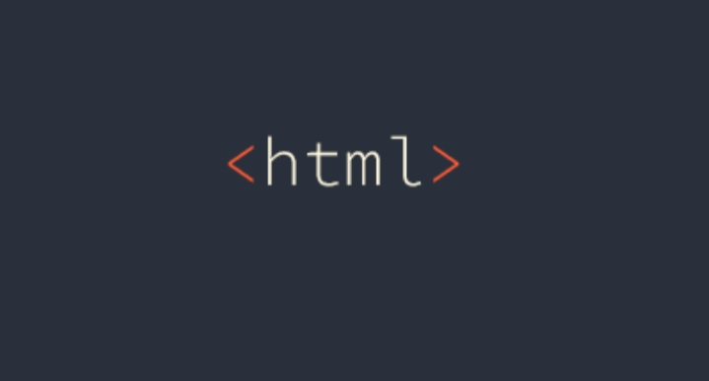
Web designing
Done by:
Boomika devi.k
21core011

Slide 2
Html tags:
<html>
<P>
<b>
<adress>
<bdi>
<bdo>
<center>
<mark>
<q>
<sub>
<sup>
<template>
<picture>
<figure>
<a>
<link>
<nav>
<ul>
<ol>
<dl>
<table>
<th>
<col>
<colgroup>
<u>

Slide 3
Explanation of html tags:
<html> - It is the root of the HTML document which is used to specify that the document is HTML.
<p> - It is used to define paragraph content in an HTML document.
<b> - It is used to specify bold content in an HTML document.
<address> - defines contact information for the author/ owner of document/ article.
<bdi> - isolates a part of text that might be formatted in a different direction form other text outside it.
<bdo> - overrides the current text direction.
<centre> - not supported in html. Use css instead. Defines centred text.
<mark> - defines marked/ highlighted text.
<q> - defines a short quotation.

Slide 4
<sup> - defines suprscripted text.
<template> - defines a container for content that should be hidden when the page loads.
<picture> - defines a container for multiple image resources.
<figure> - specifies self-contained content.
<a> - defines hyperlink.
<link> - defines the relationship between a document and an external resources ( most used to link to style sheet.
<nav> - defines navigation links.
<ul> - It is used to list the content without order.
<ol> - It is used to list the content in a particular order.
<dl> - defines a description list.

Slide 5
<table> - A table tag is used to create a table in an HTML document.
<th> - defines a header cell in a table. By default, it set the content with the bold and centre property.
<col> - specifies column properties for each column within a <colgroup> element.
<colgropup> - specifies a group of one or more columns in a table for formatting.
<u> - defines some text that is unarticulated and styled differently from normal text.
<sub> - defines subscript text. Subscript text appears half a character below the normal line and is sometimes rendered in a smaller font. Subscript text can be used for chemical formulas.

